Slide 1

Wikisource and Archive Database Explorations
December 2, 2025

Slide 2
Context

Slide 3
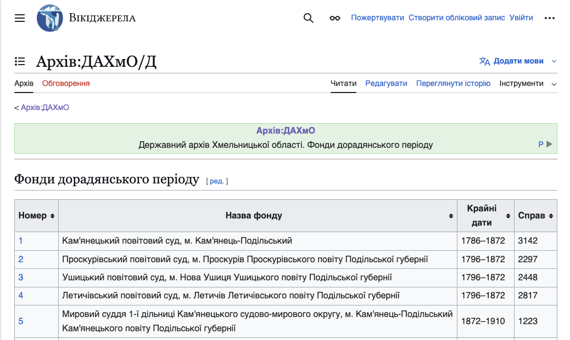

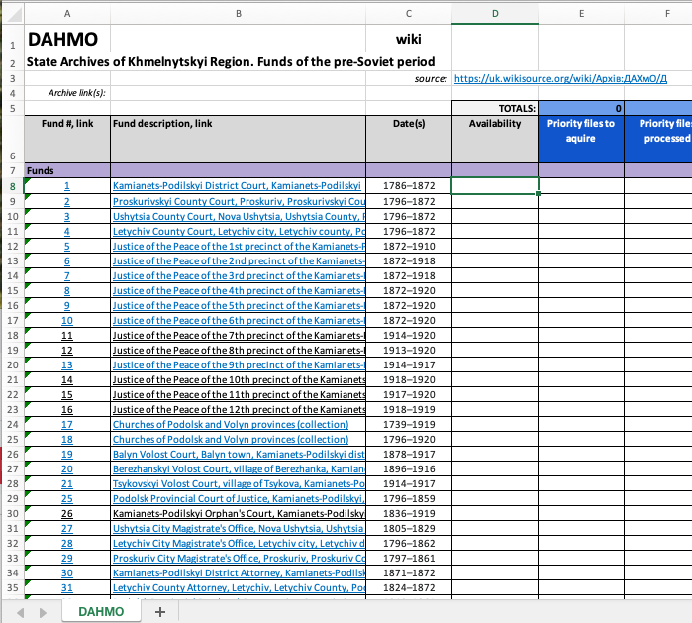
Existing Administrator Workflow
10,000+ changes per month
Overwhelming email notifications
😰
https://uk.wikisource.org
Copy/paste by the 100’s or 1,000’s
150,000+ pages to track

Slide 4
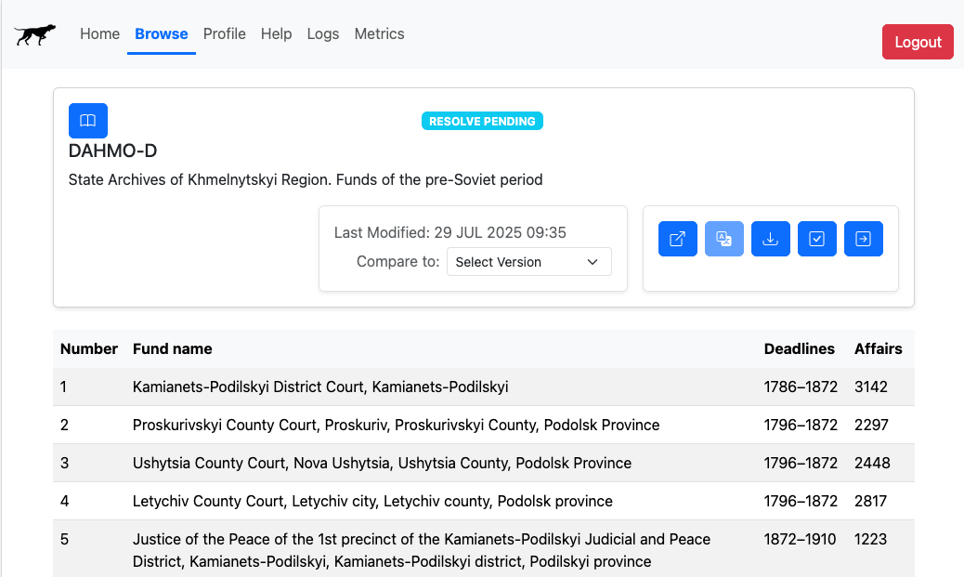
Birddog-Assisted Workflow
Built-in translation
😊
Automated spreadsheet generation
Streamlined change review
Consolidated change alerts

Slide 5
Bird Dog Features

Slide 6
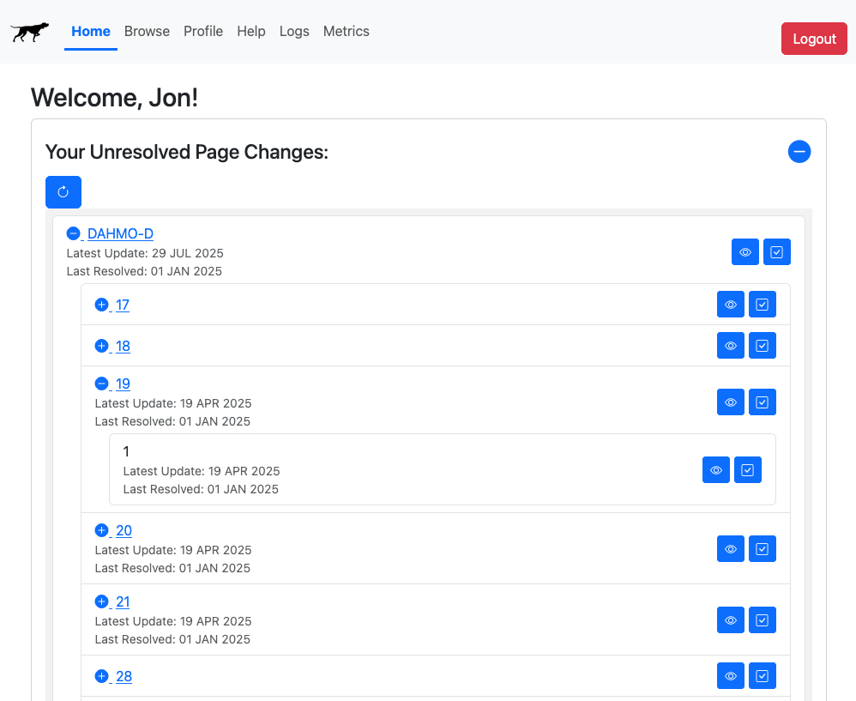
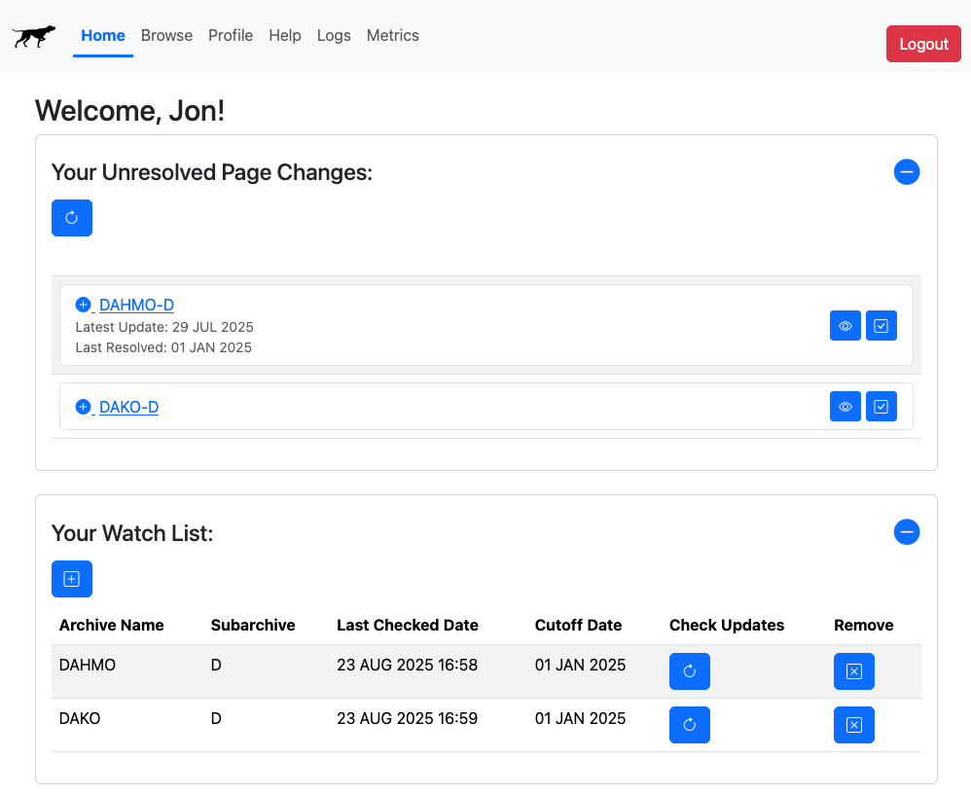
Bird Dog Features
Automated Wiki page change monitoring and reporting

Slide 7
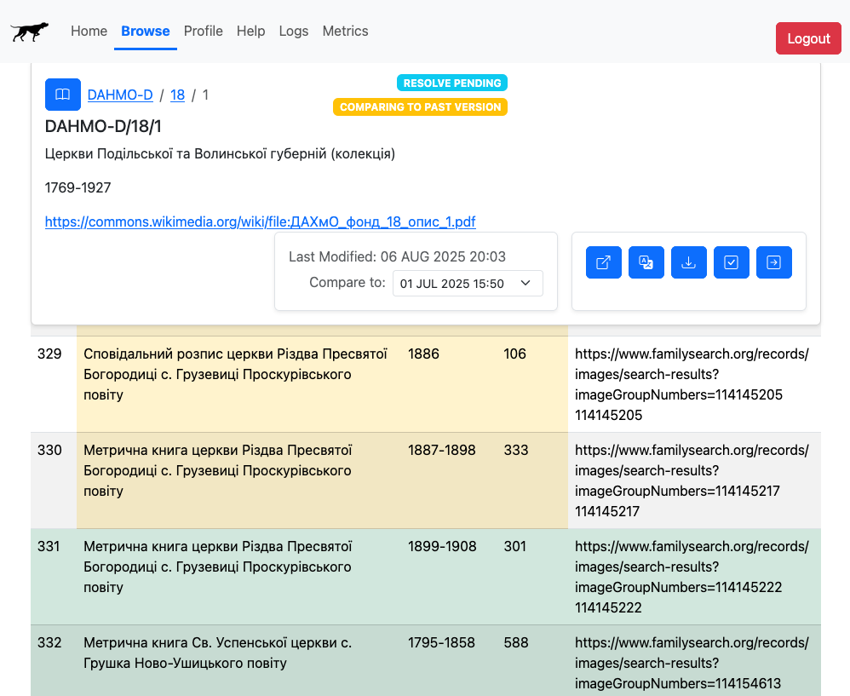
Bird Dog Features
Page change inspector in an easily digestible format
Text changes shown in yellow
Text additions shown in green

Slide 8
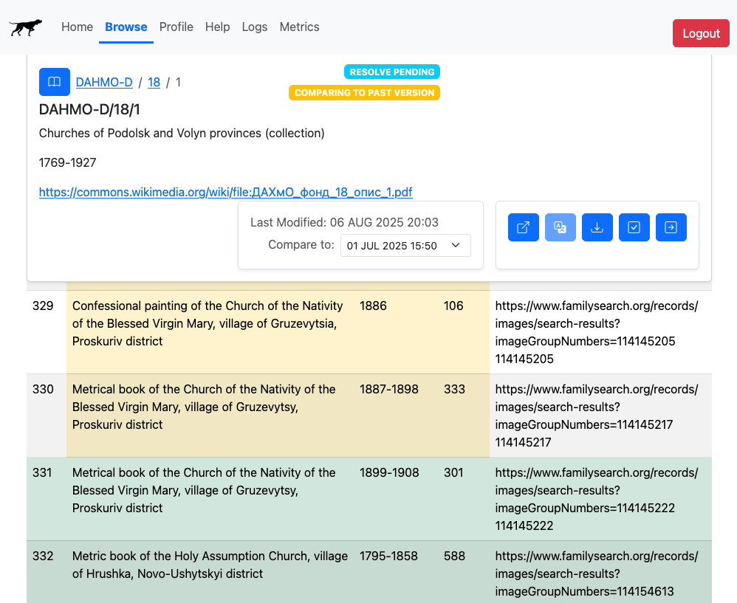
Bird Dog Features
Built-in Ukranian to English translation

Slide 9
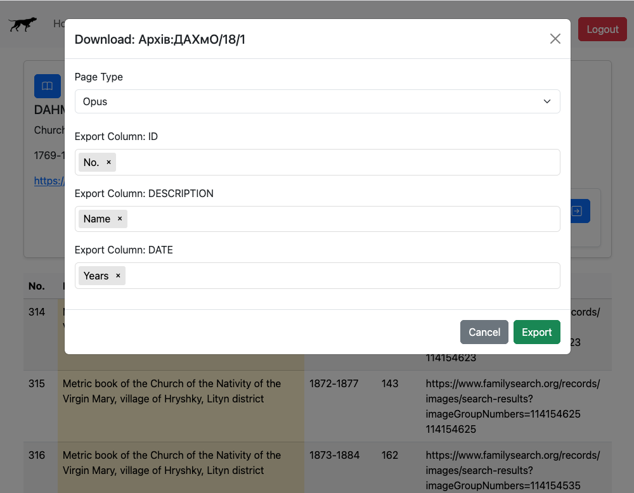
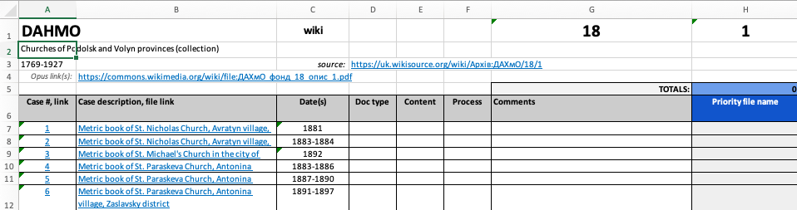
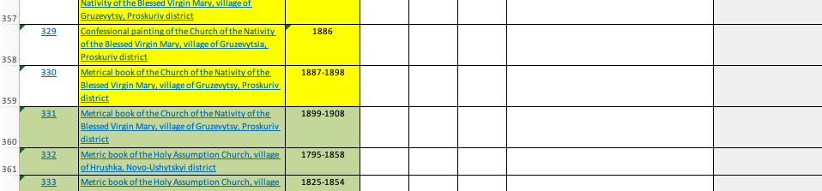
Bird Dog Features
Streamlined spreadsheet generation

Slide 10
Birddog Status
Up and running 24/7 on AWS
1 active user
2 active developers
Ready for next steps…
AWS Elastic Beanstalk
Google Cloud Translate
Flask Server (Python)
Web Client
(HTML/JS)
uk.wikisource.org
API
Bootstrap UI Framework
S3 (Storage)
DynamoDB (NoSQL database)

Slide 11

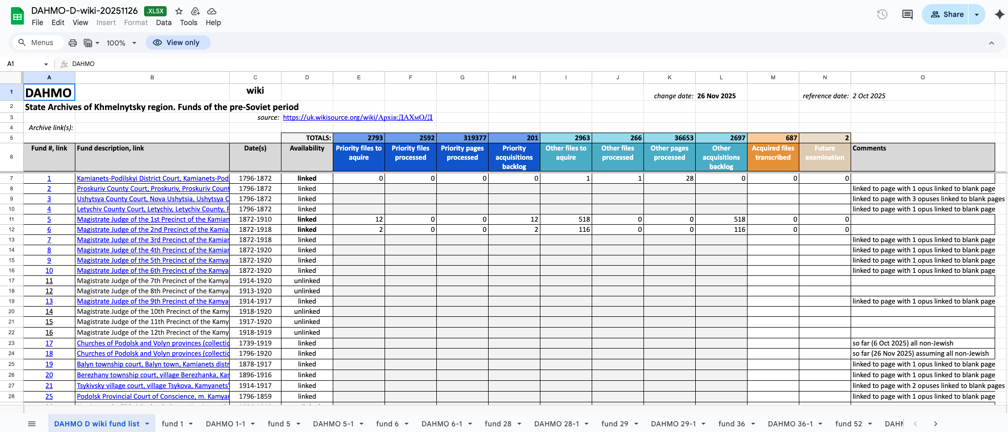
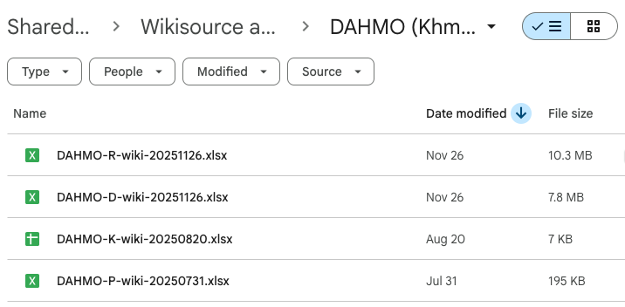
Bigger Picture

Slide 12
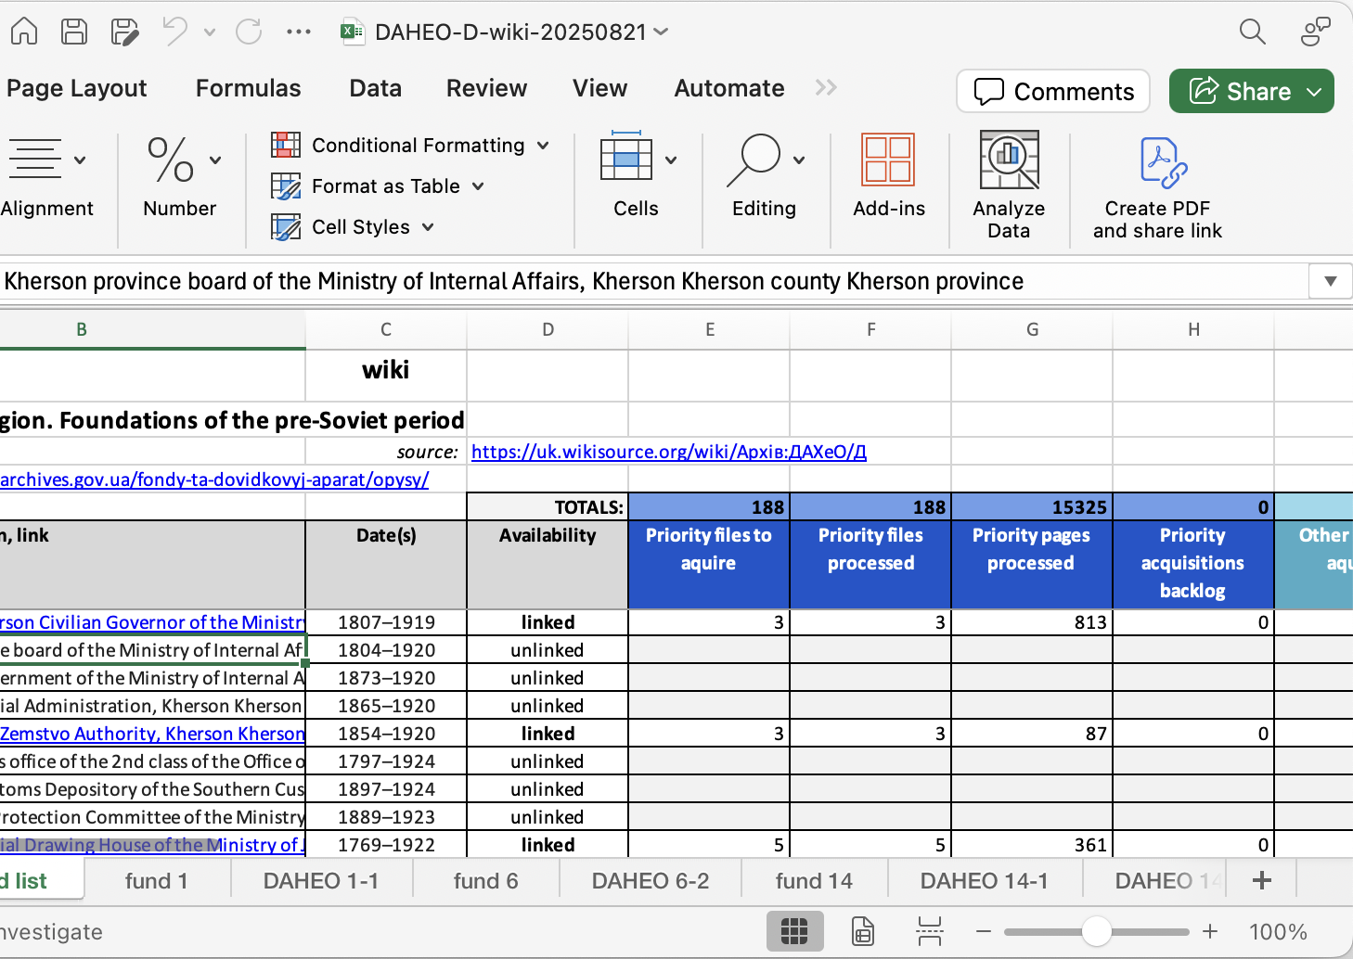
The Problem
With Google Drive spreadsheets,
View and Data are not separated
Labor intensive to maintain
Fragile multi-tab relationship structure
Not amenable to multi-person access
Hard to revise sheet structure
Hard to scale

Slide 13

The Solution
Replace Google Drive with a Database that
Separates data from view
Is easy to maintain and evolve
Can scale
Allows multiple concurrent users
Replaces multi-tab spreadsheets with evolvable, role-specific views
Replaces cross-sheet process reporting formulas with automated roll-ups
Provides built-in back-up, journaling of data changes, and commenting
Facilitates further automation, such as AI-assisted triage, etc.

Slide 14
Database Requirements
Low cost
Multi-user
Easy learning curve
Sufficient variety of views
Coexists with Birddog and Google Drive
Easily grow and transform with evolving needs
No lock-in: possible to migrate out down the road
Role-based access rights

Slide 15
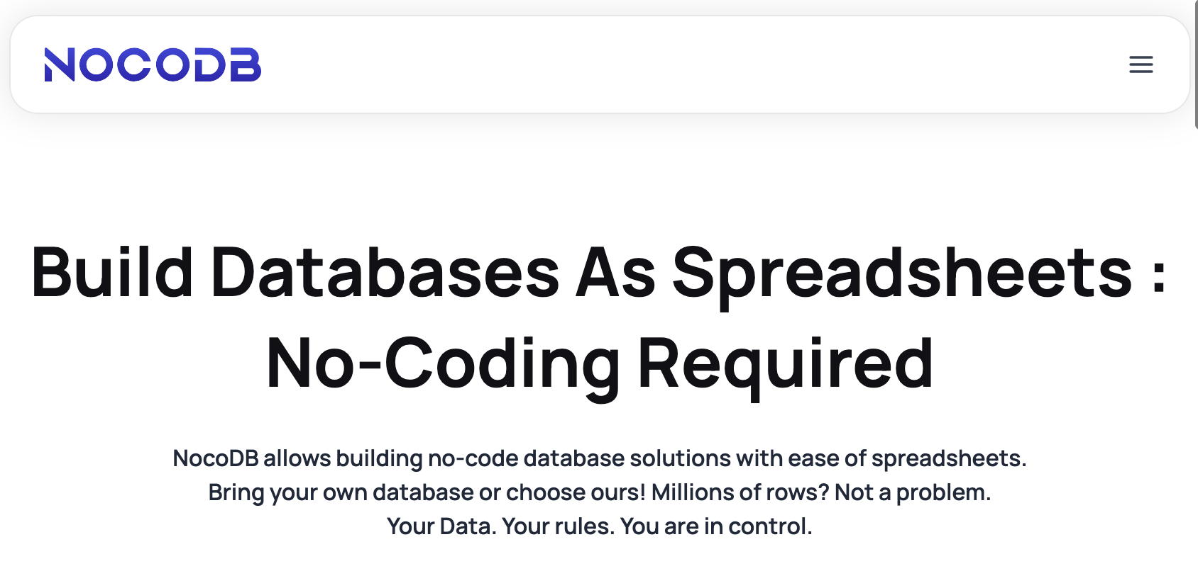
Candidate Database Platform: NocoDB
Low cost
Easy to learn (like AirTable)
Opensource
Open database
Available as hosted solution
Can be self-hosted too
https://nocodb.com/

Slide 16
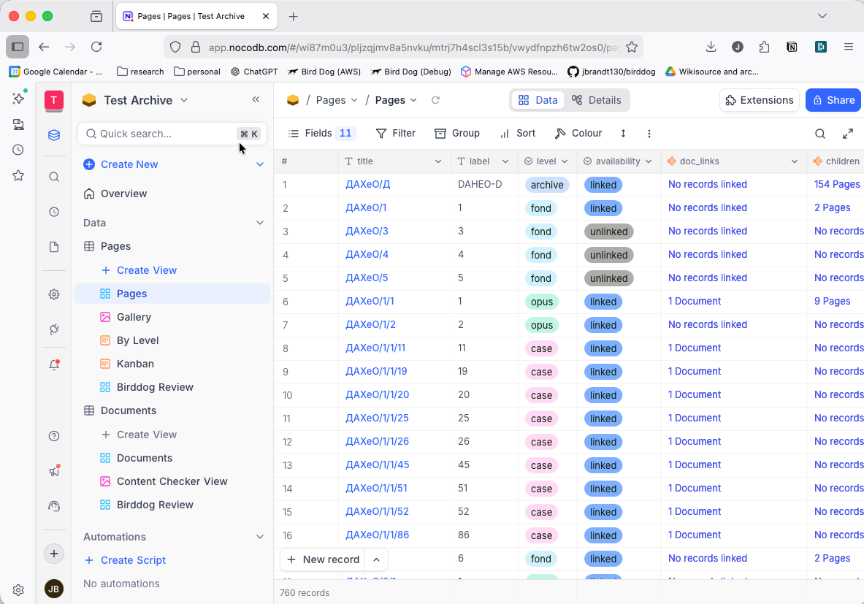
NocoDB Web App

Slide 17
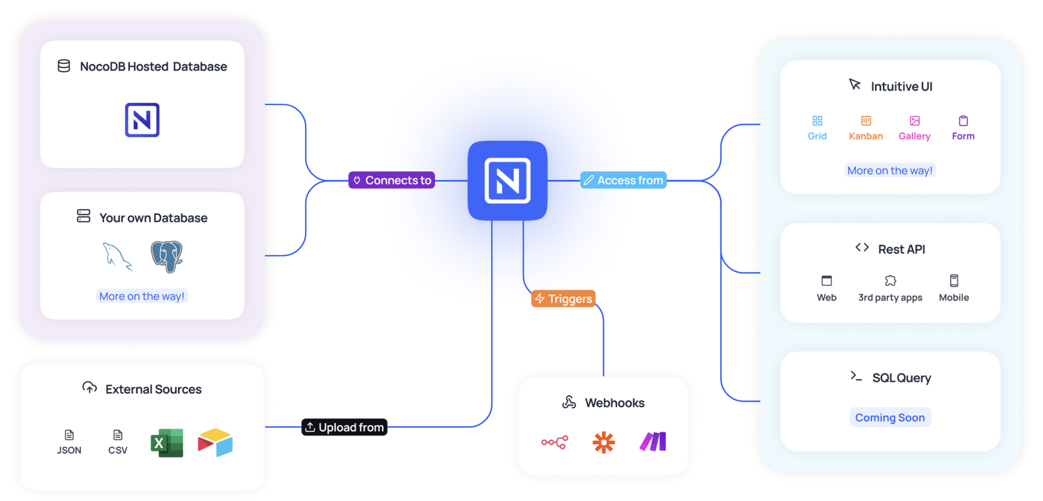
NocoDB Features

Slide 18
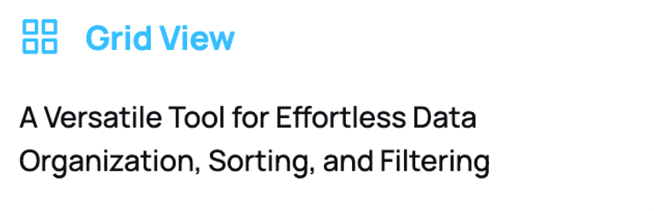
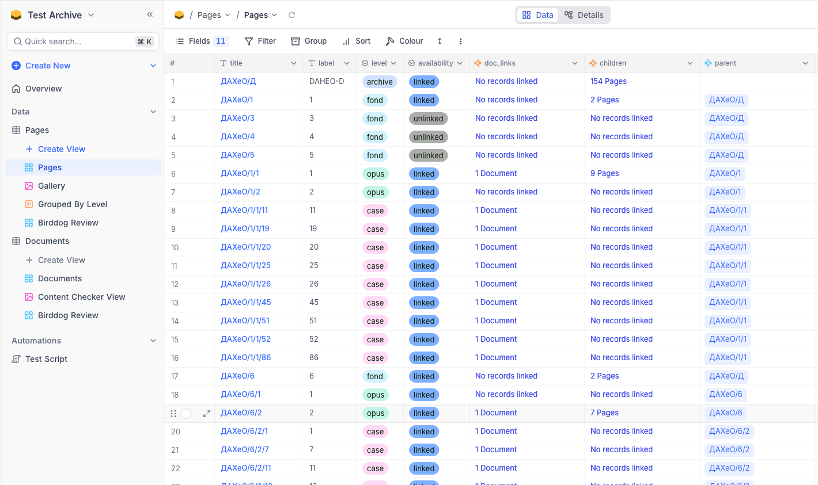
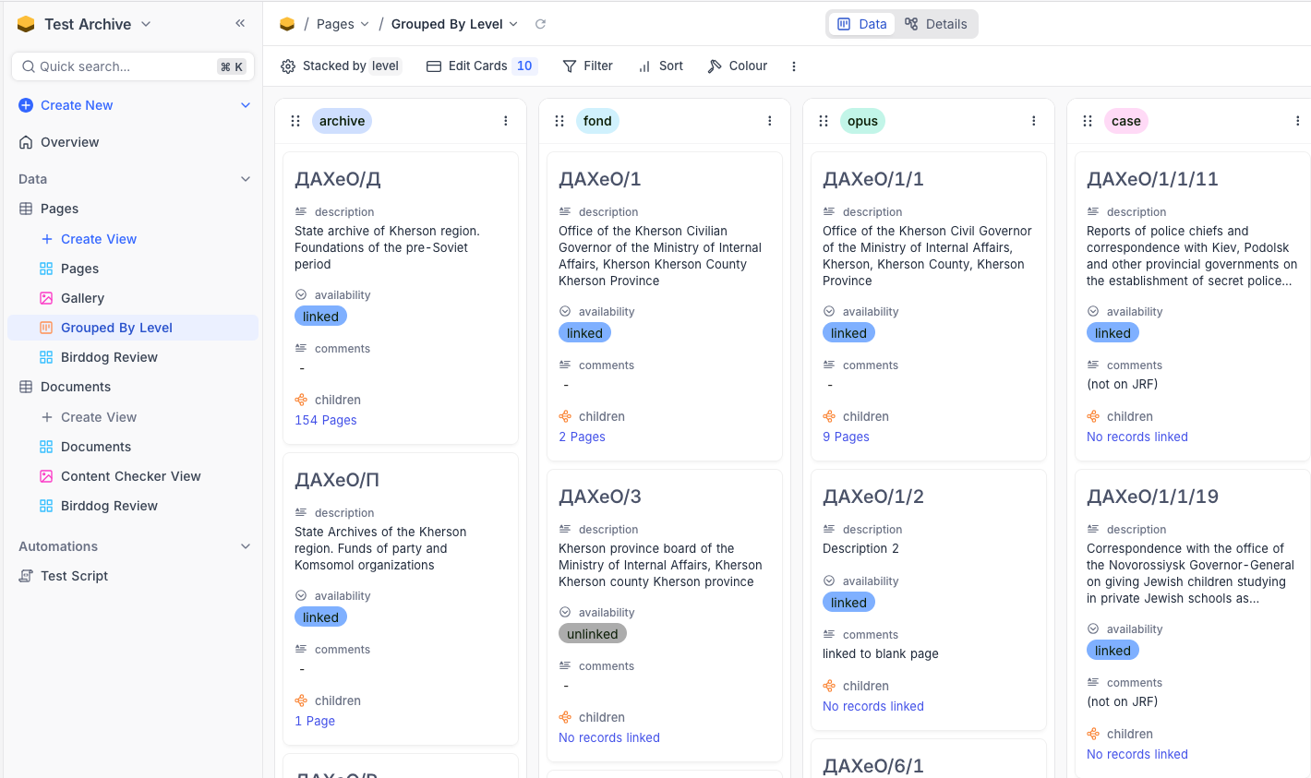
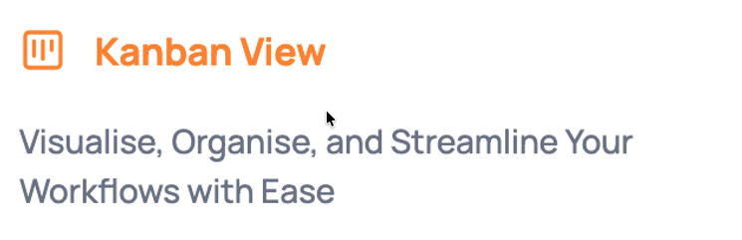

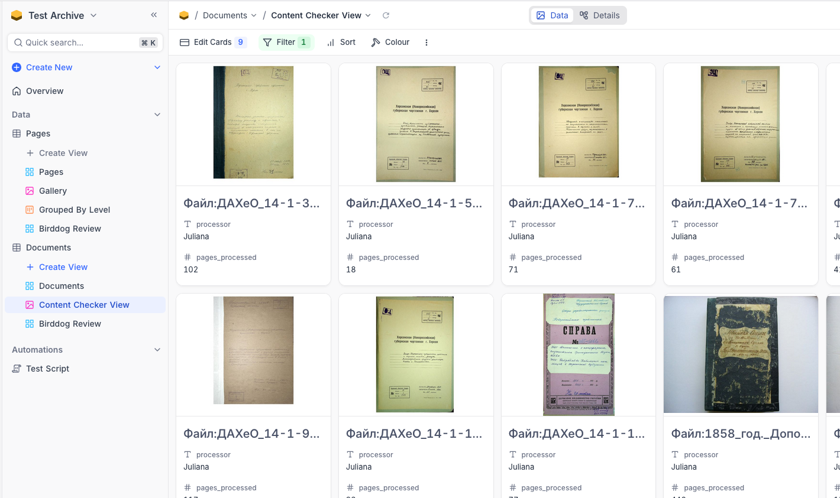
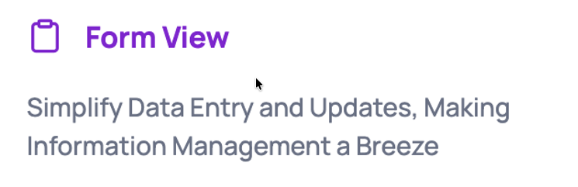
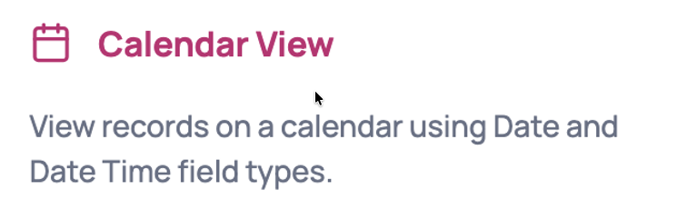
Customizable Views

Slide 19
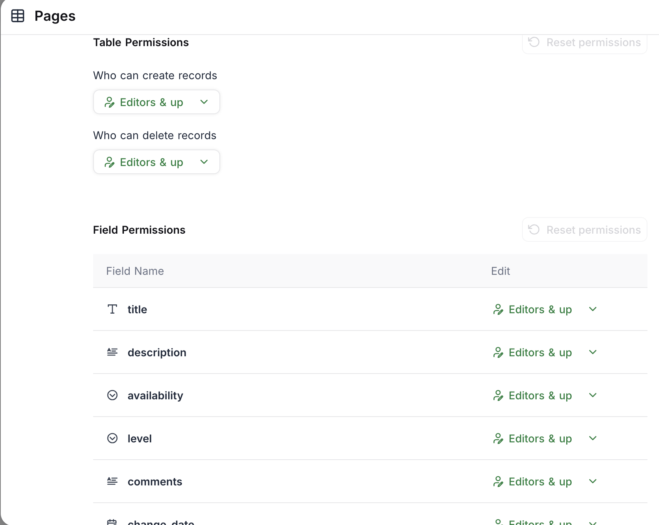
Role-Based Data Access Permissions

Slide 20
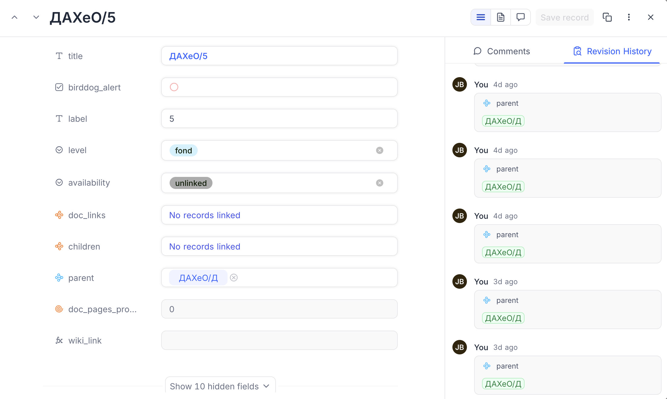
Revision History for All Data Changes

Slide 21
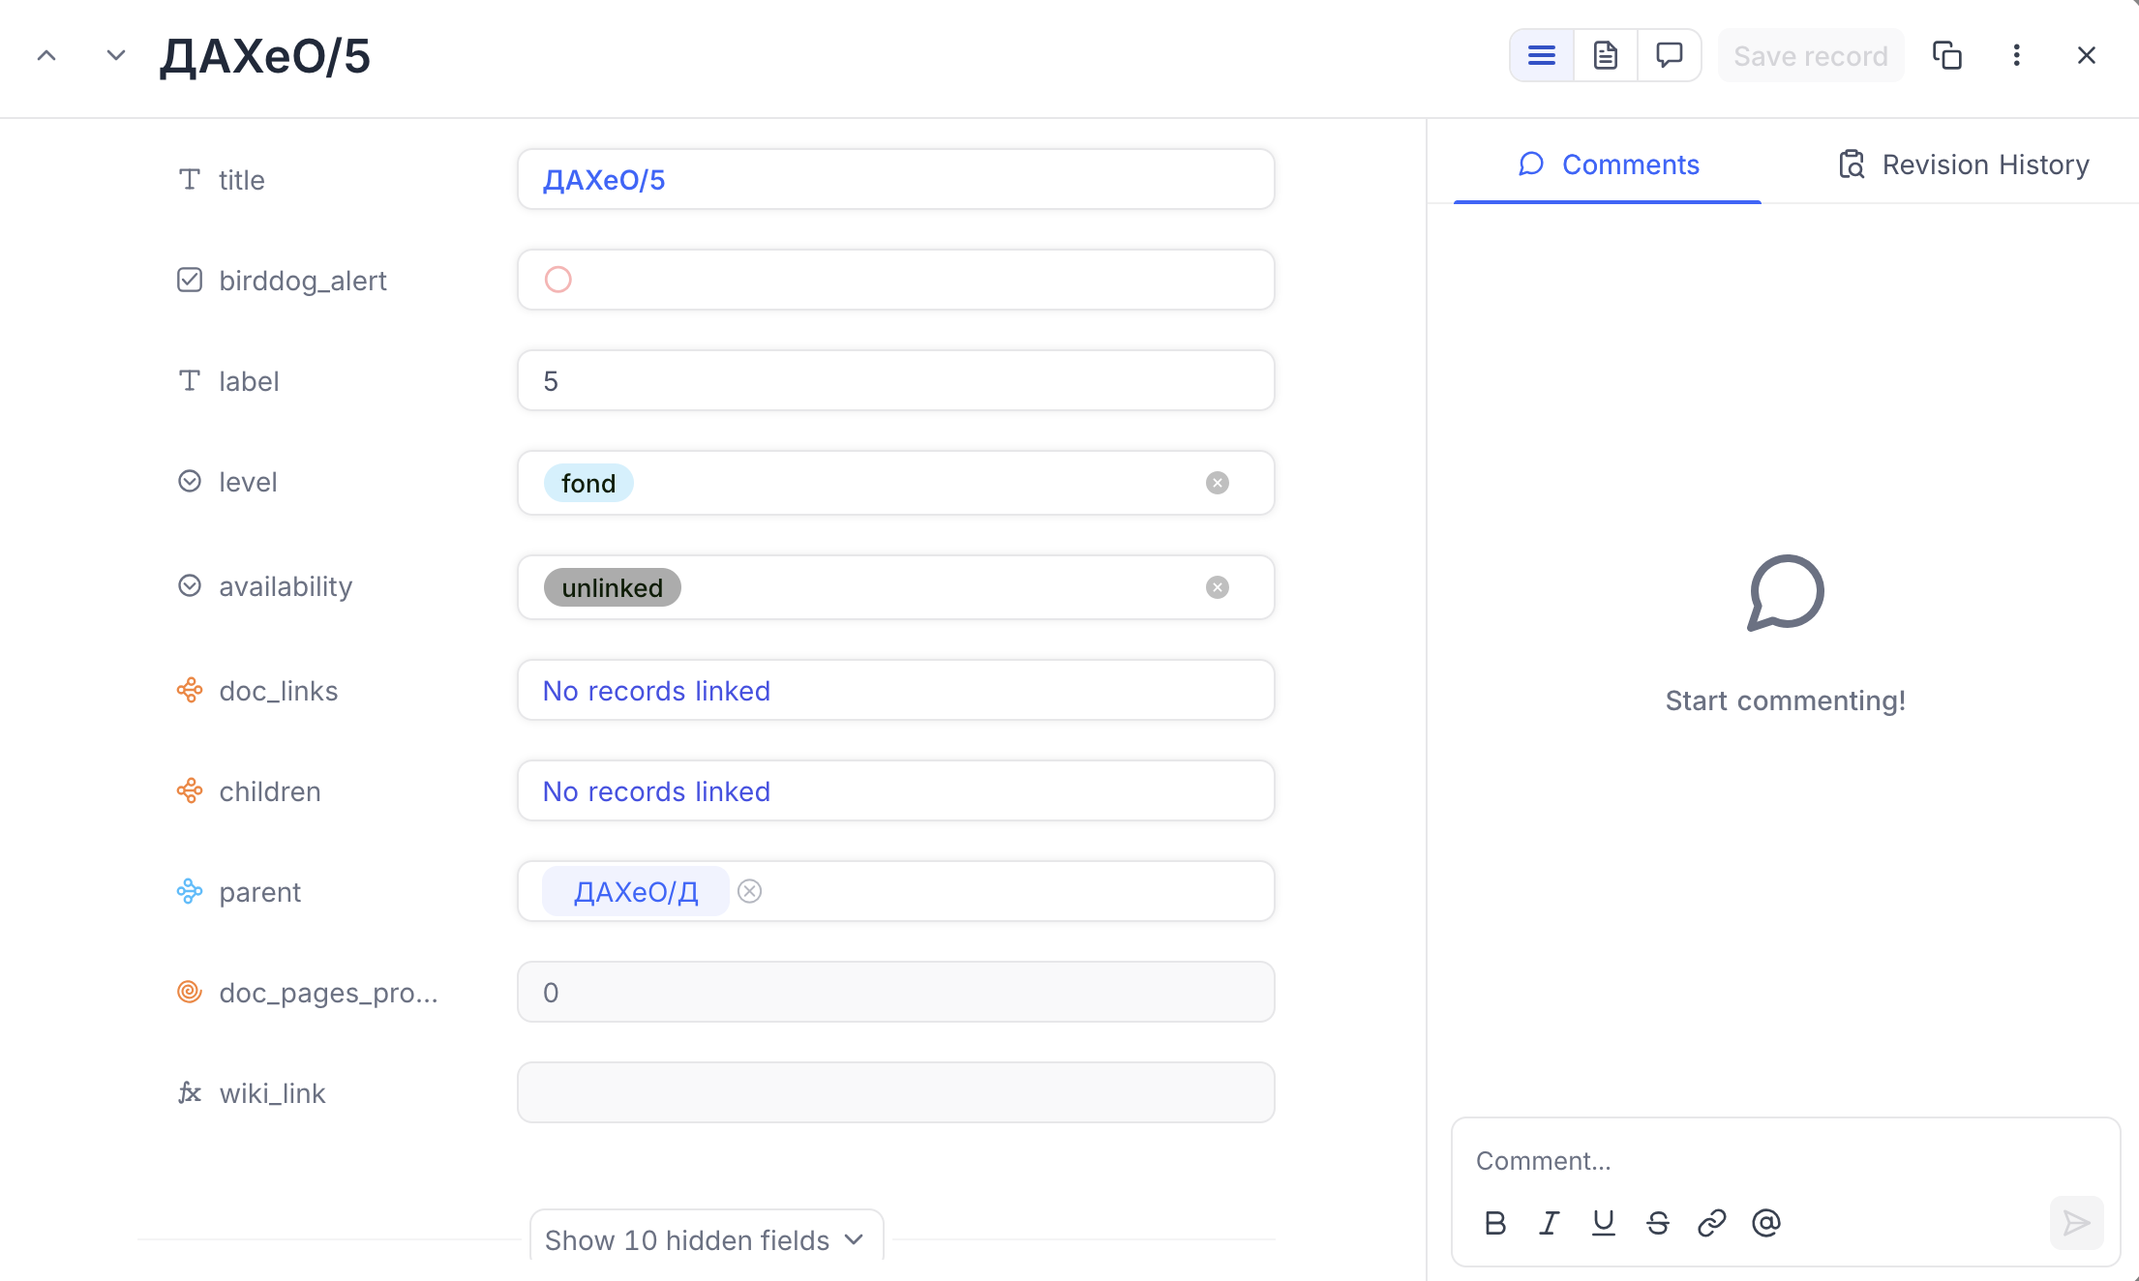
Per-Record Commenting

Slide 22
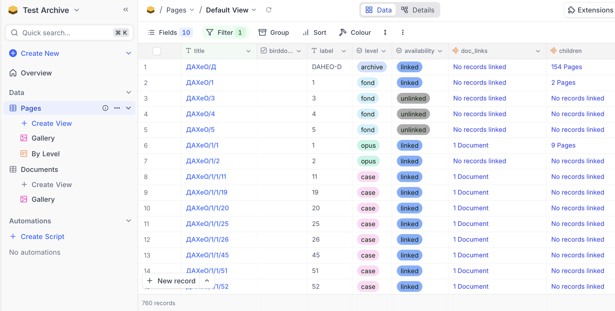
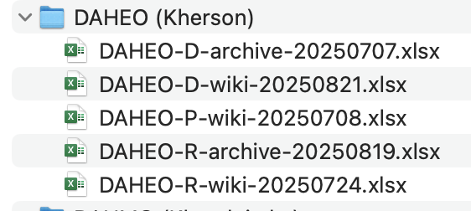
Initial Experiment with DAHEO

Slide 23
Database Schema
Separate Page data from Scanned Document data
“Page”
A Wiki or Archive web page
Title
Level (archive, fund, opus, case)
Availability (linked, unlinked)
Parent (page)
Children (pages)
Documents
“Document”
An attached scanned document
Document link
Document type
Content code
Process code
Processor
Pages processed
Owning page

Slide 24
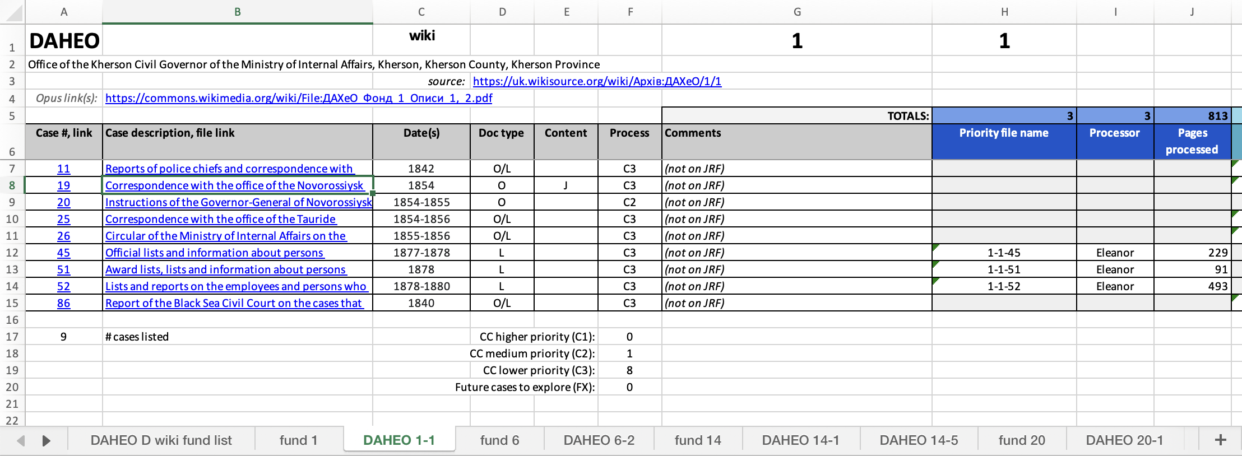
Mapping Spreadsheet Columns to Database Schema
Page Data
Document Data
Document Links

Slide 25
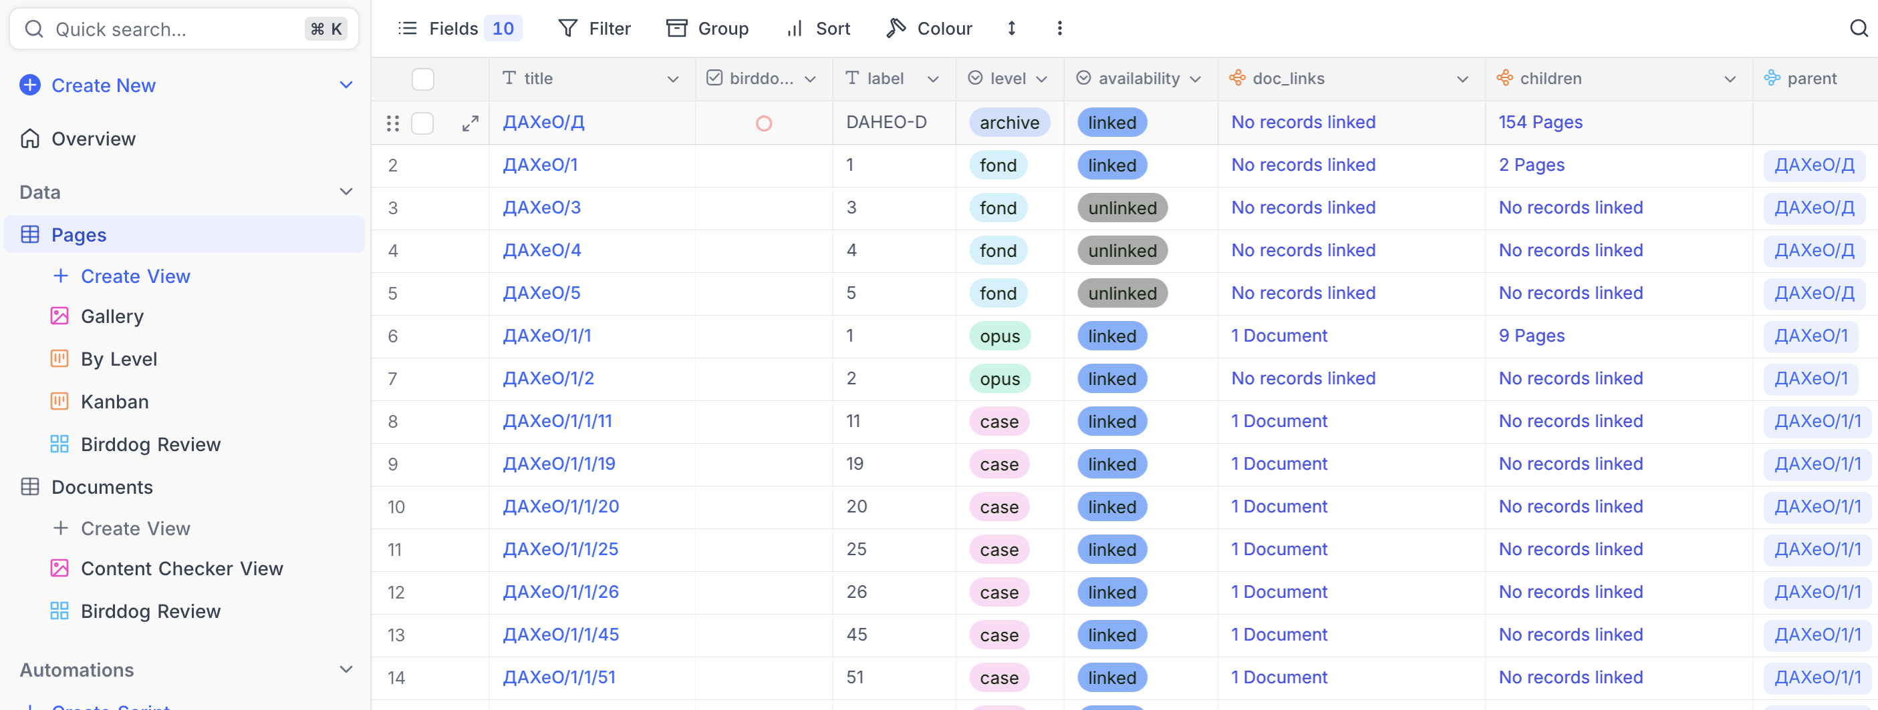
Pages Table

Slide 26
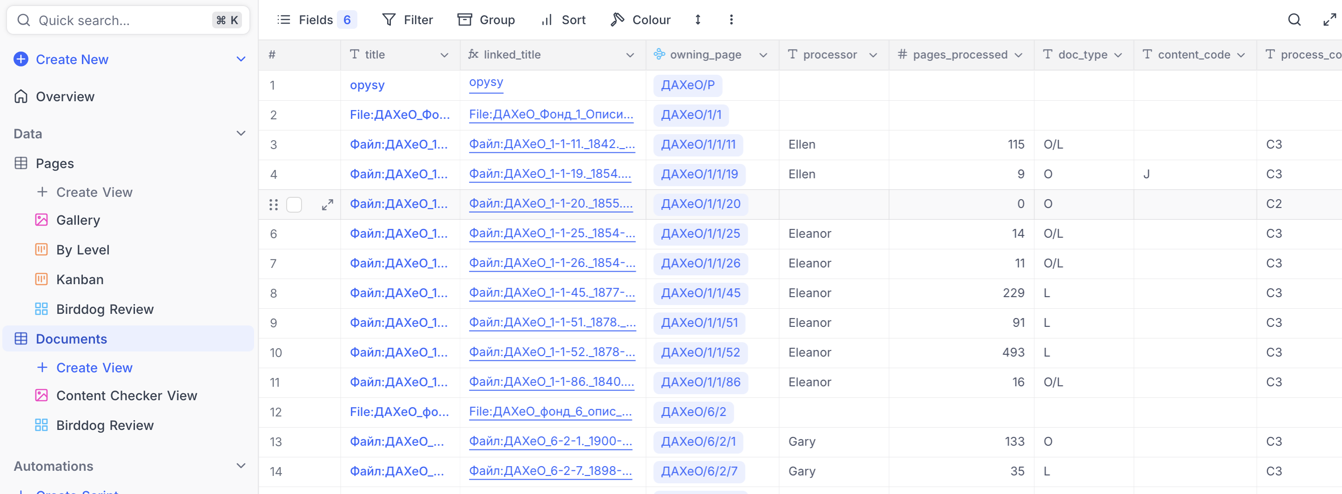
Documents Table

Slide 27
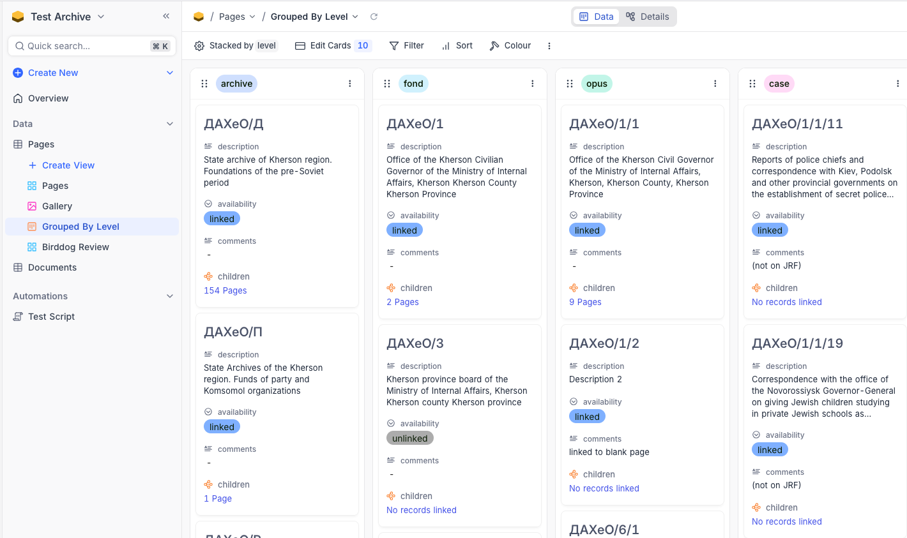
'Kanban” View of Pages table

Slide 28
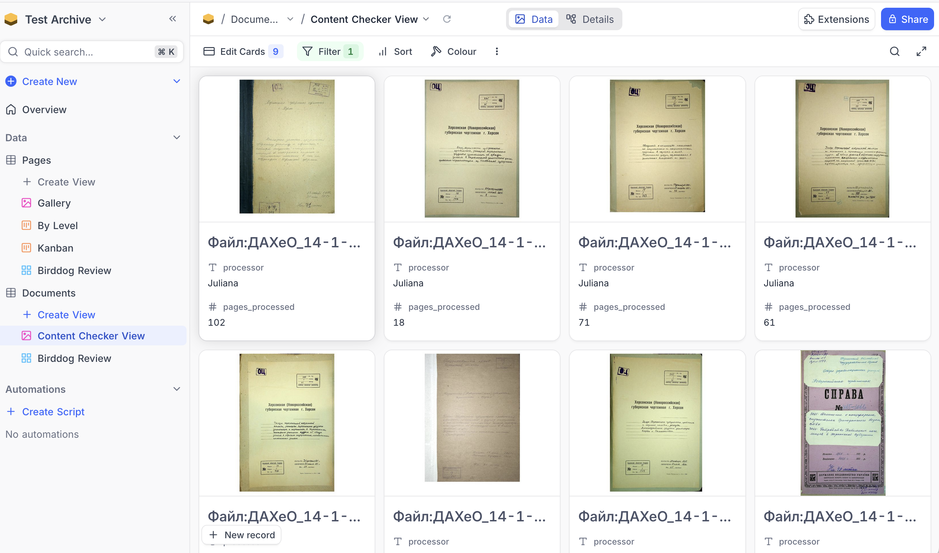
Gallery View for Content Checkers

Slide 29
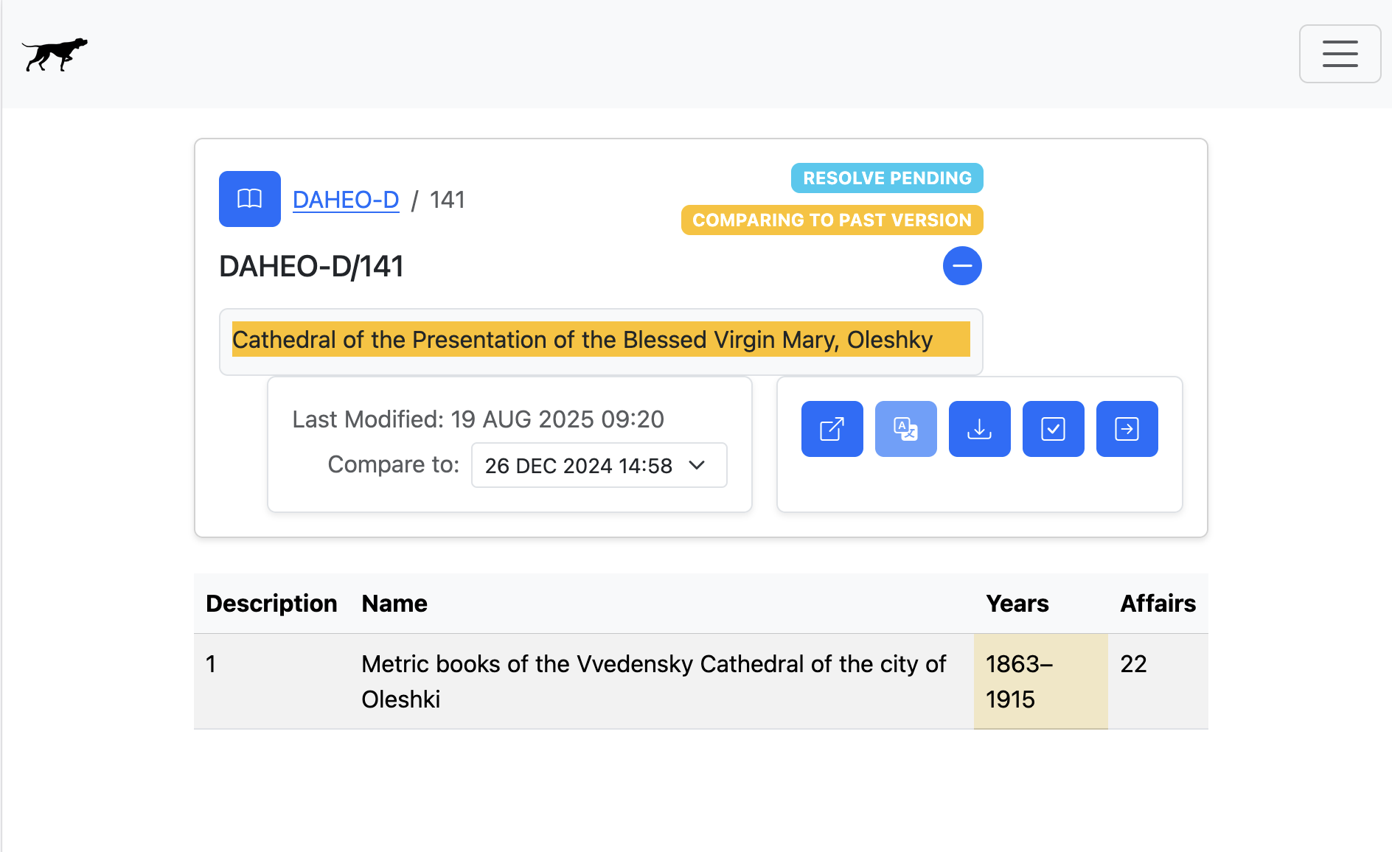
Birddog Integration (NOT YET!)
“Update database”

Slide 30
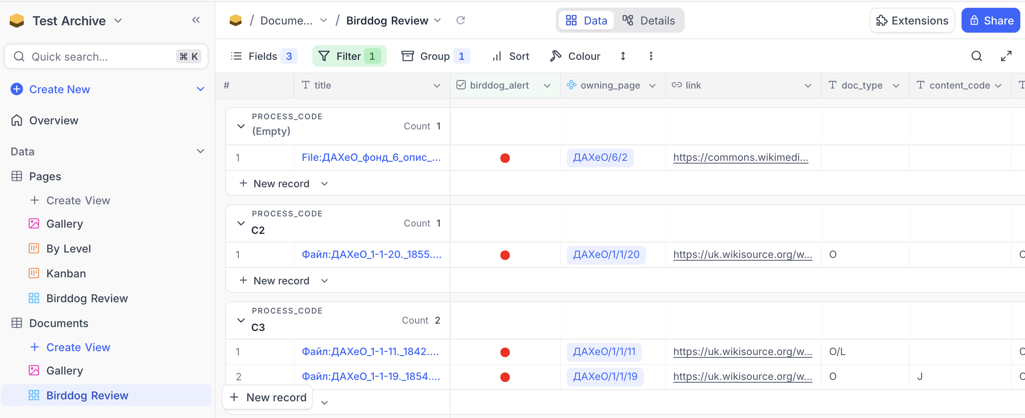
Mock-Up View for Reviewing Birddog Updates

Slide 31


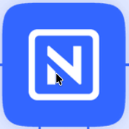
“Baby Steps” Strategy
Ongoing Work
Google Drive
Wikisource
Birddog
Validate the platform choice incrementally.
Information gathering from team(s)
Birddog integration experiments
Identify and flesh out roles and views
Develop in parallel with ongoing Google Drive-based workflows.
Transition when we’re ready.
Snapshots
Database
Database Development

Slide 32

Transition Process
Existing Google docs spreadsheet content is imported into the database to start.
Google docs continues to be used during the transition period.
Individual archive tracking is sequentially cut over to the database when ready.
Birddog is integrated to insert database updates based on ongoing Wiki archive changes.

Slide 33

Key Concept
Separation of Views from Data
Data
Views

